Slide 1

Flight Predictions

Slide 2

Objective
What:
Build a model to predict the arrival delays of US flights
Why:
Operational Efficiency
On Time Performance (OTP)
Customer satisfaction
Notes:
https://www.claimcompass.eu/blog/why-is-my-flight-delayed/
^ reasons why flights are delayed
Maybe if we want can include a graphic
It is critical for airlines to estimate flight delays as accurately as possible because the results can be applied to improving both customer satisfaction and airline income
On Time Performance (OTP) = lower cost – one of the main airline metrics
Customer satisfaction = topline rev
Talking: SEAN

Slide 3
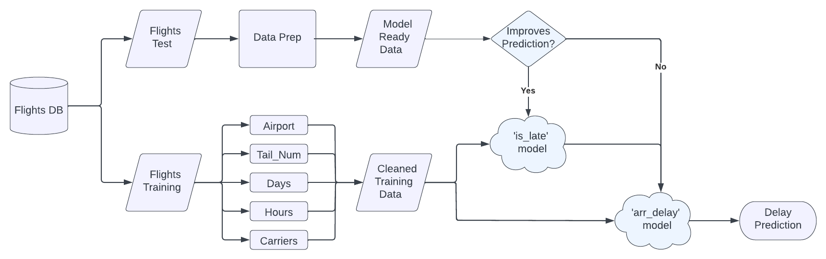
Data Pipeline
Notes:
Talking: Joe

Slide 4
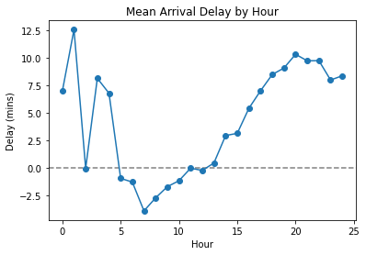
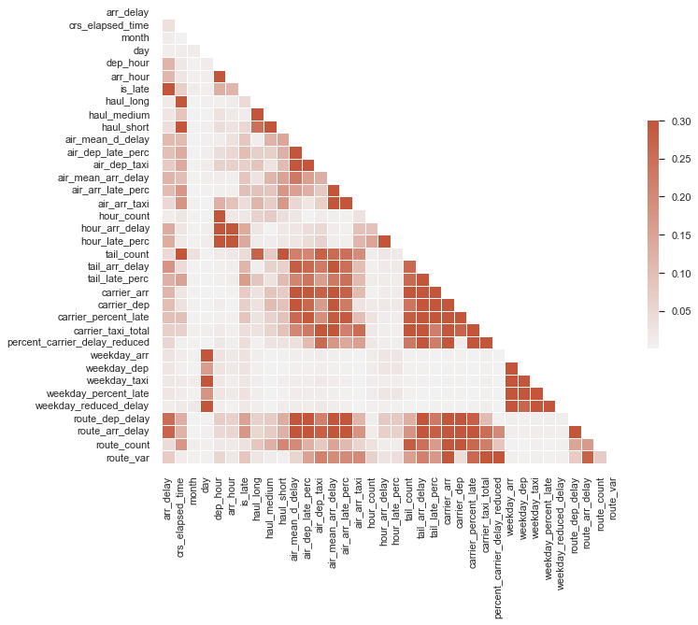
Feature Engineering
New features by airport, carrier, tail number, and time:
Arrival delay %
Arrival delay average
Other: STD / Var / Counts
Notes:
We added time and got the average daily and hourly
stats for flight delays based on the initial Flights table
Talking: Sean

Slide 5
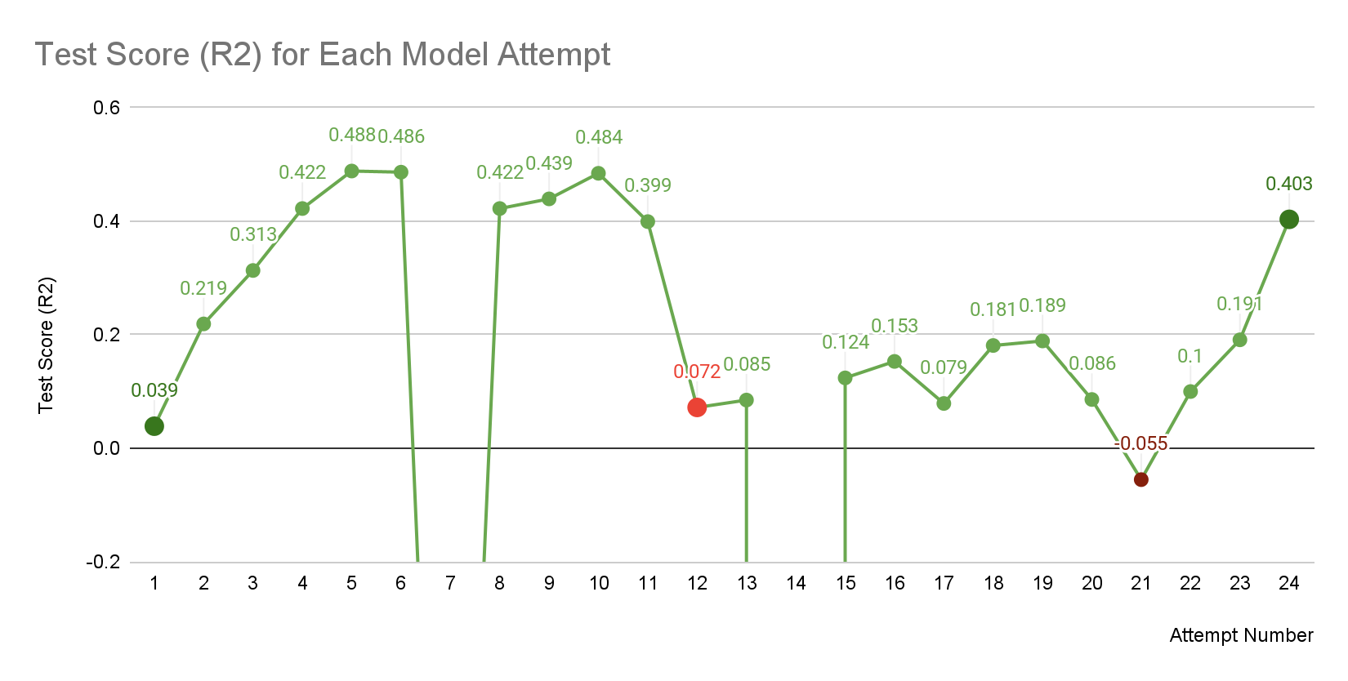
Modeling Journey
GBC + LR
Linear Reg
Polly Reg
Elastinet
RF XGBOOST
Panic & Despair
Linear Reg
Sample size: 127k
Size: 600k
Size: 127k
Size: 600k
Size: 127k
Size: 500k
Notes:
Talking: Joe

Slide 6
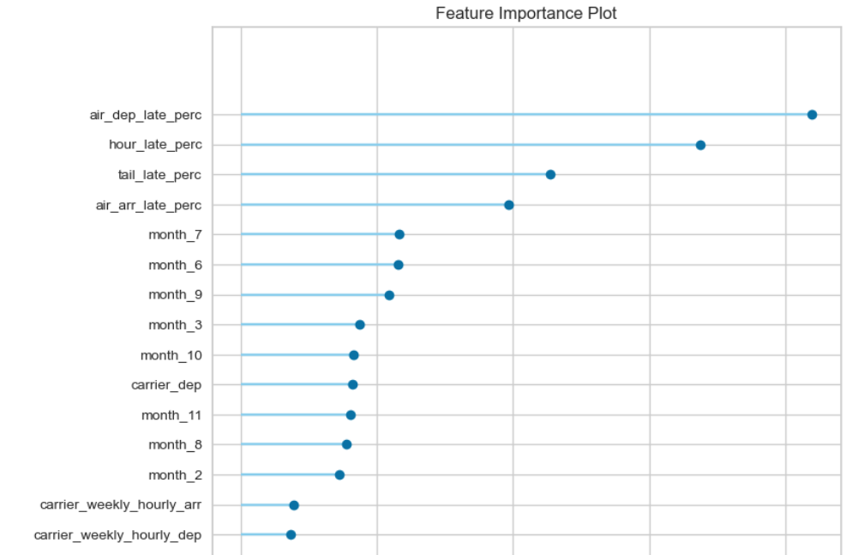
Business Impacts
Base for more complex prediction model
Operational output
Scheduling to physical crew
Communicative
Notify Airports
Customers
Staff

Slide 7

Conclusion
Various Challenges: resource consideration
Data & Feature Engineering > Models & Tuning
Why? Improved Business Efficiency
Notes:
Various Challenges: resource consideration
Data & Feature Engineering > Models & Tuning = less is more
The why: Business Efficiency

Slide 8
Notes:
Talking: Joe

Slide 9
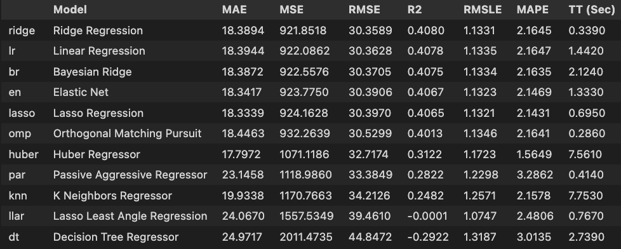
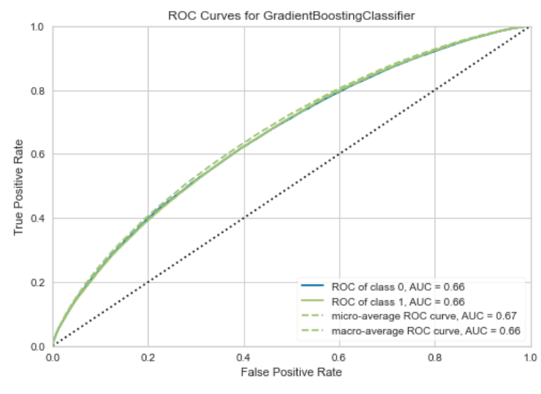
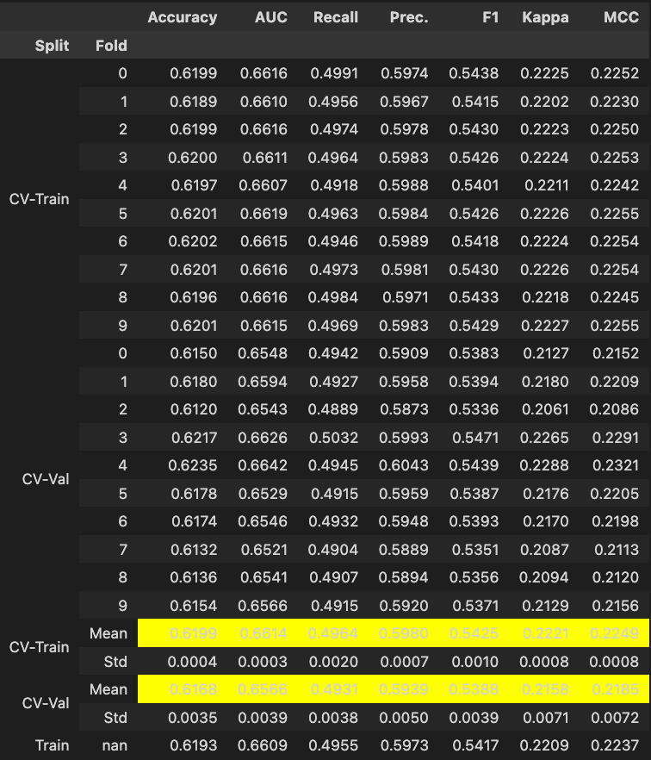
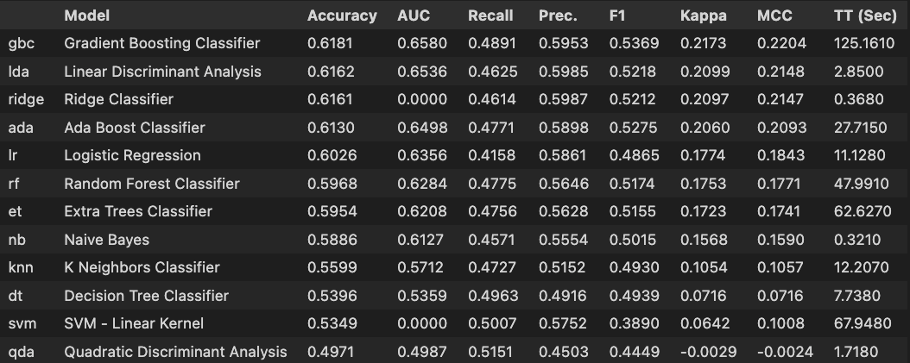

Slide 10
Binary Classification Model

